Slide 1
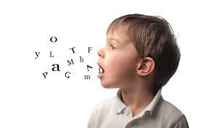
SPEECH
DIRECT AND REPORTED

Slide 2
IN THE ENGLISH LANGUAGE, THERE ARE TWO WAYS OF CONVEYING WHAT SOMEONE ELSE HAS SAID:
DIRECT/QUOTED SPEECH AND
INDIRECT/REPORTED SPEECH.

Slide 3

DIRECT SPEECH
WHAT IS IT?
DIRECT/QUOTED SPEECH, INVOLVES QUOTING THE EXACT WORDS UTTERED BY THE PERSON, WITHIN INVERTED COMMAS OR QUOTATION MARKS.
5TH SEPTEMBER 2020
Anne said, “I will be coming home tonight”.
statement

Slide 4
INDIRECT SPEECH
INDIRECT/REPORTED SPEECH, ON THE OTHER HAND, DOES NOT HAVE TO BE WITHIN QUOTES OR REPORTED WORD-TO-WORD. IN FACT, UNLESS ONE IS RELAYING THE EXACT WORDS SPOKEN, ONE SHOULD NEVER USE QUOTATION MARKS.
5TH SEPTEMBER 2020
She said that she would be coming home that night.
statement

Slide 5
NOTE
Quotation marks are not used in reported speech.
Verb tenses, pronouns and some “time” and “place” words may change because the time, place and speaker may be different.
When we report a statement, we use reported verbs such as say, tell, explain, inform, answer, decide, etc. often followed by that.

Slide 6
POLL QUESTION
1. INDIRECT SPEECH IS WHEN ONE QUOTES THE EXACT WORDS SPOKEN BY A SPEAKER.
A) TRUE
B) FALSE

Slide 7
ANSWER
ANSWER: FALSE
EXPLANATION: THE STATEMENT IS FALSE. DIRECT SPEECH IS WHEN ONE QUOTES THE EXACT WORDS SPOKEN BY A SPEAKER. FOR EXAMPLE, NEHA SAID “I AM VERY TIRED NOW.”

Slide 8
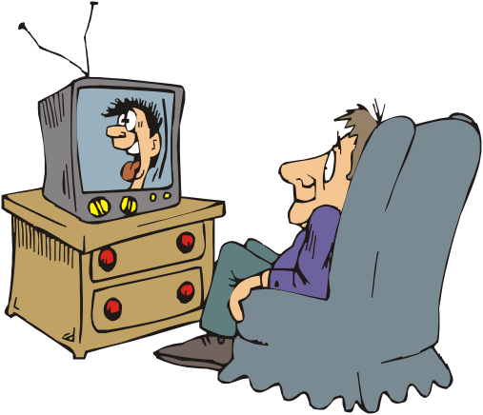
What changes in a sentence in Reported Speech?
1. The verbs
2. The pronouns and possesive adjectives
3. Some adverbs (now and there words)
I am watching my favourite programme now
Tom said (that) he was watching his favourite programme then

Slide 9
1. Verb tense changes:
Present Simple
Past Simple
Past Perfect
Past Simple
Present Perfect
Past Perfect
Future (will)
(would)
Examples:
I saw a snake
She said (that) she had seen a snake
She will come
He said (that) she would come

Slide 10
TENSE CHANGE
Present simple tense | INTO ➔ | Past simple
Present Continuous tense |  | Past continuous
Present Perfect tense |  | Past perfect
Present Perfect Continuous |  | Past perfect continuous
Past Simple |  | Past Perfect
Past Continuous |  | Past Perfect Continuous
Future simple, will |  | would
Future Continuous, will be |  | would be
Future Perfect, will have |  | would have

Slide 11
POLL QUESTION
WHILE CONVERTING DIRECT SPEECH TO INDIRECT, SIMPLE PRESENT BECOMES A SIMPLE PAST.
A) TRUE
B) FALSE

Slide 12
ANSWER
ANSWER: TRUE
EXPLANATION: THE STATEMENT IS TRUE. WHILE CONVERTING DIRECT SPEECH TO INDIRECT, SIMPLE PRESENT BECOMES A SIMPLE PAST.

Slide 13

2. Pronouns & adjectives changes:
It depends on the person who the message is referred to
You are stupid!
She said that I was stupid
She said that we were stupid
She said that he was stupid

Slide 14
CHANGES IN PRONOUNS
Direct
speech
Reported
speech
Direct
speech
Reported
speech
I
He, she
my
His, her
you
I, she, he, we, they
your
My, his, her, our,
their
we
they
Me
Him, her
our
their
mine
His, hers
You
Him, her, us, them
yours
Mine, his, hers, ours,
theirs
  Us
them
ours
Mine, his , hers, ours, theirs

Slide 15




3. Now and there words:
Some adverbs have to change in order to keep the same meaning.
They said (that) they were waiting there
We are waiting here

Slide 16
CHANGES IN TIME AND ADVERBS
Changes to
Today | that day/the same day
Tomorrow | the next day/the following day
Yesterday | the day before/the previous day
Next week/month/year | the following week/month/year
Last week/month/year | the previous week/month/year
Now/just | then
Ago | before
Here | there
This | that

Slide 17
TYPES OF SENTENCES
Statements
Questions
Commands
A. In statements, you change verbs,pronouns and adverbs. To introduce the reported sentence you use say or tell.
‘I am watching tv now’
He said (that) he was watching tv then
He told me (that) he was watching tv then

Slide 18
POLL QUESTION
IF THE REPORTED SPEECH EXPRESSES SOME UNIVERSAL TRUTH, HABIT, HISTORICAL INCIDENT OR PERMANENT FACT, ITS TENSE DOES NOT CHANGE EVEN WHEN THE REPORTING VERB IS IN THE PAST TENSE.
A) TRUE
B) FALSE

Slide 19
ANSWER
. ANSWER: TRUE
EXPLANATION: THE STATEMENT IS TRUE. IF THE REPORTED SPEECH EXPRESSES SOME UNIVERSAL TRUTH, HABIT, HISTORICAL INCIDENT OR PERMANENT FACT, ITS TENSE DOES NOT CHANGE EVEN WHEN THE REPORTING VERB IS IN THE PAST TENSE. FOR EXAMPLE, DIRECT SPEECH: THE TEACHER SAID, “NEW DELHI IS THE CAPITAL ON INDIA.” REPORTED SPEECH: THE TEACHER SAID THAT NEW DELHI IS THE CAPITAL OF INDIA.

Slide 20
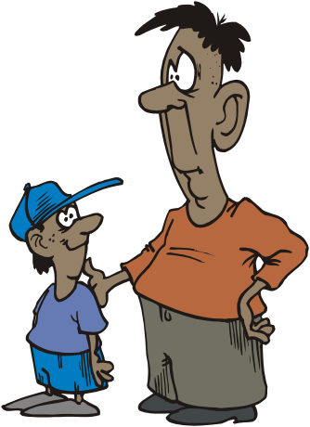


B. There are two types of questions:
B.1. Information questions (wh questions):
Reported questions change the word order
You usually write asked to introduce the reported sentence
When will Sally and Tom come for dinner?
Peter asked me when you would come for dinner

Slide 21
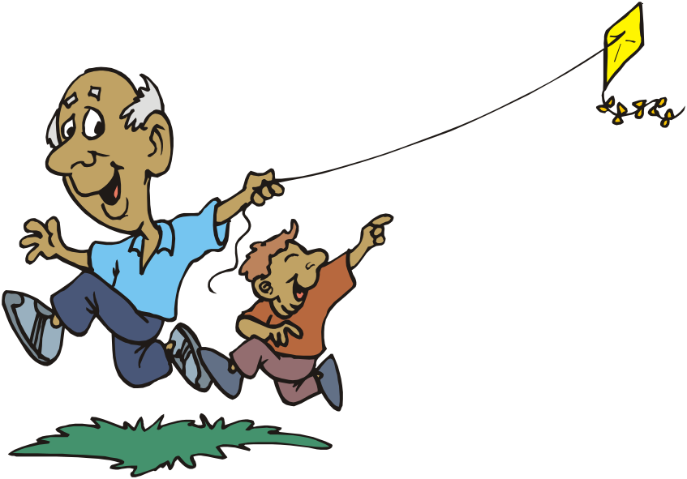
B.2. Yes/No questions
If/whether is used to introduce reported questions that do not start with wh words.
‘Is it windy today?’
Kevin asked his grandfather if it was windy that day

Slide 22
POLL QUESTION
WHILE CHANGING A QUESTION INTO INDIRECT SPEECH, THE REPORTING VERB MUST BE CHANGED INTO ASKED, INQUIRED OR DEMANDED.
A) TRUE
B) FALSE

Slide 23
ANSWER
ANSWER: TRUE
EXPLANATION: THE STATEMENT IS TRUE. WHILE CHANGING A QUESTION INTO INDIRECT SPEECH, THE REPORTING VERB MUST BE CHANGED INTO ASK, INQUIRE OR DEMAND. ALSO, THE QUESTION MARK MUST BE REMOVED.

Slide 24
IMPERATIVE SENTENCE
A SENTENCE WHICH EXPRESSES COMMAND, REQUEST, ADVICE OR SUGGESTION IS CALLED IMPERATIVE SENTENCE.
FOR EXAMPLE,
• OPEN THE DOOR.
• PLEASE HELP ME.
• LEARN YOUR LESSON.

Slide 25
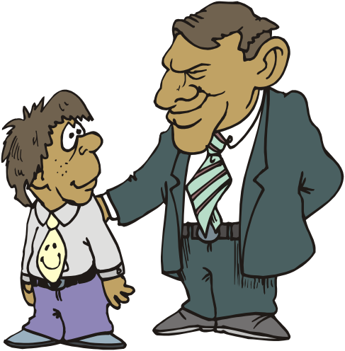
C. Commands
In commands you change the imperative into infinitive
‘Go and do your homework’
Paul ordered his son to go and do his homework

Slide 26
Direct speech | Indirect Speech
He said to me, “please help me”. | He requested me to help him.
She said to him, “you should work hard for exam”. | He suggested him to work hard for exam.
They said to him, “do not tell a lie”. | They said to him not to tell a lie.
He said, “open the door”. | He ordered to open the door.
The teacher said to student, “do not waste time”. | The teacher advised the students not to waste time.

Slide 27
EXCLAMATORY SENTENCES
SENTENCE WHICH EXPRESSES STATE OF JOY OR SORROW OR WONDER IS CALLED EXCLAMATORY SENTENCE.
FOR EXAMPLE.
HURRAH! WE WON THE MATCH.
ALAS! I FAILED THE TEST.
WOW! WHAT A NICE SHIRT IT IS.

Slide 28
REPORTING VERB IS CHANGED INTO EXCLAIMED WITH JOY/SORROW/ SURPRISE APPLAUDED .ETC. AS PER THE MENTIONED EMOTION IN THE SENTENCE.
INVERTED COMMAS WILL BE ELIMINATED WITH THE USE OF ‘THAT’.
THE EXCLAMATION MARK (!) NEEDS TO BE CHANGED INTO A FULL STOP. (.)

Slide 29
Direct speech | Indirect Speech
He said, “Hurrah! I won a prize” | He exclaimed with joy that he had won a prize.
She said, “Alas! I failed in exam” | She exclaimed with sorrow that she failed in the exam.
John said, “Wow! What a nice shirt it is” | John exclaimed with wonder that it was a nice shirt

Slide 30
PRACTICE!
1. HE SAID, “I HAVE GOT A TOOTHACHE”.
2. MANU SAID, “I AM VERY BUSY NOW”.
3. “HURRY UP,” SHE SAID TO US.
4. “GIVE ME A CUP OF WATER,” HE TOLD HER.
5. SHE SAID, “I AM GOING TO COLLEGE.”
6. SHE SAID TO ME, “THANK YOU”
7. RAJU SAID, “GAUTAM MUST GO TOMORROW”.
8. GEETHA SAYS, “MY FATHER IS AN ENGINEER.”
9. HE SAID, “I HAVE PASSED THE PHYSICAL TEST.”
10. SHE SAID TO ME, “YOU ARE MY ONLY FRIEND.”
11. ‘I LOVE YOU,’ HE TOLD ME.
12. ‘WHERE ARE YOU GOING?’ JAMES ASKED MARY.

Slide 31
ANSWERS
1. HE SAID THAT HE HAD GOT A TOOTHACHE.
2. MANU SAID THAT HE WAS VERY BUSY THEN.
3. SHE TOLD US TO HURRY UP.
4. HE ASKED HER TO GIVE HIM A CUP OF WATER.
5. SHE SAID THAT SHE WAS GOING TO COLLEGE.
6. SHE THANKED ME.
7. RAJU SAID THAT GAUTAM WOULD HAVE TO GO THE FOLLOWING DAY.
8. GEETHA SAYS THAT HER FATHER IS AN ENGINEER.
9. HE SAID THAT HE HAD PASSED THE PHYSICAL TEST.
10. SHE TOLD ME THAT I WAS HER ONLY FRIEND.
11. HE TOLD ME THAT HE LOVED ME.
12. JAMES ASKED MARY WHERE SHE WAS GOING.

Slide 32
PRACTICE!
1.“WHY DO YOU WANT TO WORK HERE?”
2. “WHAT KIND OF EXPERIENCE DO YOU HAVE MANAGING A TEAM?”
3. “HOW MANY YEARS DID YOU WORK AS A FREELANCE REPORTER?”
4. “WHAT WAS THE MOST CHALLENGING THING ABOUT YOUR LAST POSITION?”
5. “WHAT KINDS OF EDITING SOFTWARE HAVE YOU USED?”
6. “HOW MUCH EXPERIENCE DO YOU HAVE AS A BEAT REPORTER?”
7. “WHY DO YOU WANT TO LEAVE YOUR CURRENT POSITION?”
8. “WHAT WERE YOUR RESPONSIBILITIES AT CKRD NEWS?”
9. “ARE YOU WILLING TO TRAVEL?”
10. “DO YOU HAVE ANY QUESTIONS FOR ME?”

Slide 33
ANSWERS
1.SHE ASKED HIM WHY HE WANTED TO WORK THERE.
2. SHE ASKED HIM WHAT KIND OF EXPERIENCE HE HAD MANAGING A TEAM.
3. SHE WANTED TO KNOW HOW MANY YEARS HE HAD WORKED AS A FREELANCE REPORTER.
4. SHE ASKED HIM WHAT THE MOST CHALLENGING THING ABOUT HIS LAST POSITION HAD BEEN.
5. SHE WANTED TO KNOW WHAT KINDS OF EDITING SOFTWARE HE HAD USED.
6. SHE ASKED HOW MUCH EXPERIENCE HE HAD AS A BEAT REPORTER.
7. SHE ASKED WHY HE WANTED TO LEAVE HIS CURRENT POSITION.
8. SHE ASKED HIM WHAT HIS CURRENT RESPONSIBILITIES WERE AT CKRD NEWS.
9. SHE WANTED TO KNOW IF HE WAS WILLING TO TRAVEL.
10. SHE ASKED HIM IF HE HAD ANY QUESTIONS FOR HER.

